Slide 1
Cleaning and manipulating datasets
Notes:
[Mandatory Slide] This would be the introduction slide of the topic that you are covering in this subsection.
When this slide plays, you could talk about the main aim that we’d be covering in this video.

Slide 2
In this Video, we are going to take a look at…
Exploring a financial dataset
Code sample: data wrangling
Notes:
[Mandatory Slide]
Before the start of the video, we’d like to highlight what are important topics or pointers that we’d be covering in this video. This slide would immediately follow the intro/name slide. This would just be say 2-3 points for the viewers to know what they are getting into.

Slide 3
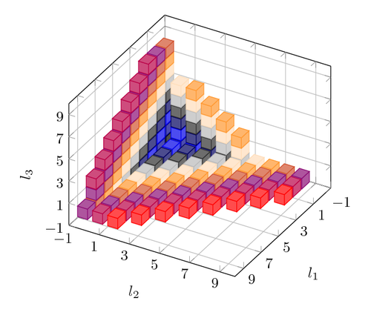
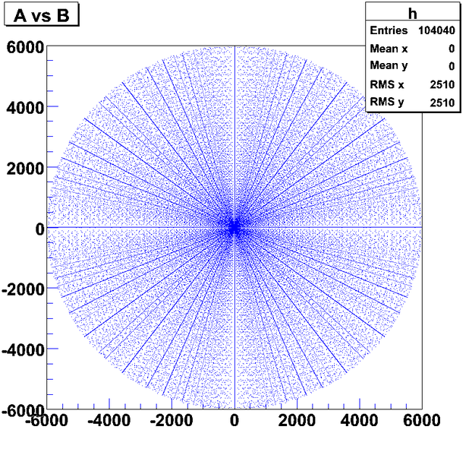

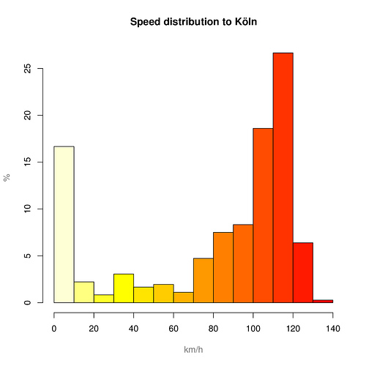
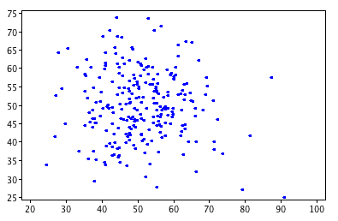


Exploring a financial dataset (1/2)
Tools like Pandas enable the data science process: that is, using concepts and techniques coming from different fields (maths, statistics, computer science, machine learning, etc.) to extract knowledge or evidences from datasets
Often, real-life datasets are time-based: for example, financial data is
Pandas shines at time-series manipulation!
We won’t calculate any technical indicator that is economically meaningful: we will just take a look at the data from a statistical point of view
Sorry for not helping very much in getting rich...
Notes:
[Mandatory Slide]
Before the start of the video, we’d like to highlight what are important topics or pointers that we’d be covering in this video. This slide would immediately follow the intro/name slide. This would just be say 2-3 points for the viewers to know what they are getting into.

Slide 4
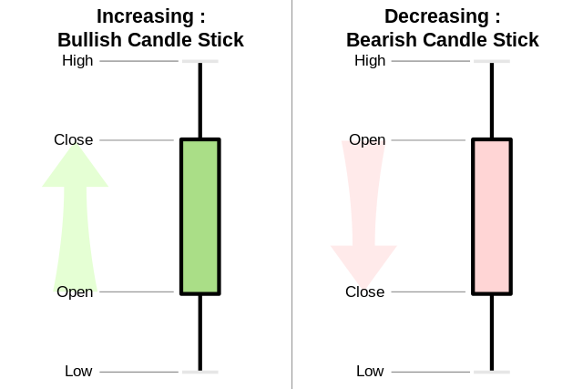
Exploring a financial dataset (2/2)
You need not be a finance guru! You just need to know this:
on each day, price for a stock has an open and close value
during the day, the stock price usually touches a maximum (high) and a minimum (close)
you can check price open, close and estrema values on any time-period (minute, hour, day, week, etc..). A compact representation for this is the Japanese candlestick one.
price ($)
high
close
open
low
2018-02-01
time (days)
We’re going to :
retrieve historical daily price performance data of four NASDAQ stocks
clean the datasets so they can be compared on a fixed reference period
compare averages and high/low peaks on a stock base and overall
resample the datasets on a different time scale and repeat the comparisons
Notes:
[Mandatory Slide]
Before the start of the video, we’d like to highlight what are important topics or pointers that we’d be covering in this video. This slide would immediately follow the intro/name slide. This would just be say 2-3 points for the viewers to know what they are getting into.

Slide 5
Code Sample:
data wrangling
Notes:
Something that needs to grab the viewers attention!!

Slide 6
Summary
Exploring a financial dataset
Code sample: data wrangling
Notes:
[Mandatory Slide]
Before the start of the video, we’d like to highlight what are important topics or pointers that we’d be covering in this video. This slide would immediately follow the intro/name slide. This would just be say 2-3 points for the viewers to know what they are getting into.

Slide 7
Visualizing datasets
Next Video
Notes:
[Mandatory Slide]
Here the name of the next video needs to be mentioned. The narration as you guessed it would be just letting the viewer know exactly where we are at and what we’d be taking over next! ☺

